Slide 1
Migrating from RDBMS to MongoDB
Buzz Moschetti
Enterprise Architect, MongoDB
buzz.moschetti@mongodb.com
@buzzmoschetti
Notes:
HELLO!
This is Buzz Moschetti at MongoDB, and welcome to today’s webinar entitled “Schema Design”
If your travel plans today do not include exploring schema design with MongoDB then please exit the aircraft immediately and see an agent at the gate
Otherwise – WELCOME ABOARD for about the next hour.

Slide 2
Before We Begin
This webinar is being recorded
Use The Chat Window for
Technical assistance
Q&A
MongoDB Team will answer quick questions in realtime
“Common” questions will be reviewed at the end of the webinar
Notes:
Some quick logistics.
In the last 5 to 10 mins today, we will answer the most common questions that have appeared in the webinar.

Slide 3
Who Am I?
Yes, I use “Buzz” on my business cards
Former Investment Bank Chief Architect at JPMorganChase and Bear Stearns before that
Over 27 years of designing and building systems
Big and small
Super-specialized to broadly useful in any vertical
“Traditional” to completely disruptive
Advocate of language leverage and strong factoring
Inventor of perl DBI/DBD
Still programming – using emacs, of course
Notes:
Very briefly, a little bit about the person talking to you today over the net.

Slide 4
Today’s Goal
Explore issues in moving an existing RDBMS system to MongoDB
What is MongoDB?
Determining Migration Value
Roles and Responsibilities
Bulk Migration Techniques
System Cutover

Slide 5

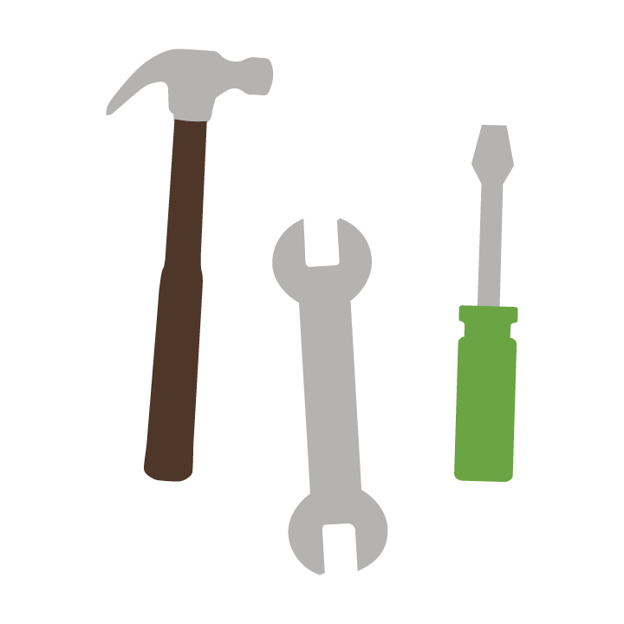
MongoDB: The Leading NoSQL Database
{
name: “John Smith”,
pfxs: [“Dr.”,”Mr.”],
address: “10 3rd St.”,
phone: {
home: 1234567890,
mobile: 1234568138 }
}
Fully Featured
High Performance
Scalable
Document Data Model
Open-Source

Slide 6
What is MongoDB for?
The data store for all systems of engagement
Demanding, real-time SLAs
Diverse, mixed data sets
Massive concurrency
Globally deployed over multiple sites
No downtime tolerated
Able to grow with user needs
High uncertainty in sizing
Fast scaling needs
Delivers a seamless and consistent experience

Slide 7
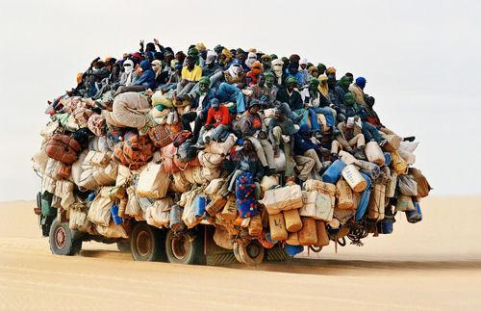
Why Migrate At All?
Notes:
Why do this at all? This isn’t easy, mongoDB or otherwise.
Changing your persistence engine is akin to a heart transplant.
You don’t do this lightly – especially if you’ve got some semblance of a functioning heart!
You would be looking at migration if you had some clear, measurable pains that prevented you from achieving your business / plaform value goals.

Slide 8
Understand Your Pain(s)
Existing solution must be struggling to deliver 2 or more of the following capabilities:
High performance (1000’s – millions queries / sec) - reads & writes
Need dynamic schema with rich shapes and rich querying
Need truly agile SDLC and quick time to market for new features
Geospatial querying
Need for effortless replication across multiple data centers, even globally
Need to deploy rapidly and scale on demand
99.999% uptime (<10 mins / yr)
Deploy over commodity computing and storage architectures
Point in Time recovery
Notes:
Not exhaustive list, and 2 isn’t the special number. Just 1 (like global replication) might be enough.
But by the same token, you don’t want to “check off” ALL of the boxes because the ones you check off drive activities and design and cost of the migration

Slide 9
Migration Difficulty Varies By Architecture
Migrating from RDBMS to MongoDB is not the same as migrating from one RDBMS to another.
To be successful, you must address your overall design and technology stack, not just schema design.
Notes:
Maybe obvious, maybe not.
Blind migration of content from RDBMS misses options to add value and also will very likely drag in technology or information architecture accomodations and work-arounds from the past.
When migrating to MongoDB, it is valuable and useful to examine the existing system stack overall.

Slide 10
Migration Effort & Target Value
Target Value = CurrentValue
+ Pain Relief
– Migration Effort
Pain Relief:
Highly Variable
Potentially non-linear
Migration Effort is:
Variable / “Tunable”
Can occur at different amounts in different levels of the stack
Notes:
The reason you want to examine the stack is because you can apply migration dollars in DIFFERENT parts of the stack, not JUST the persistor.
This forms a set of possible migration options, each with a cost / value equation.
And not all investments yield the same leveragable value.
It is important at the very start to EXPLORE YOUR OPTIONS.

Slide 11
The Stack: The Obvious
Apps
POJOs
ORM
SQL / ResultSet
JDBC
Assume there will be many changes at this level:
Schema
Stored Procedure Rewrite
Ops management
Backup & Restore
Test Environment setup
RDBMS
Storage Layer
Notes:
Of course, in addition, you’ll got training and certification, etc. etc.,

Slide 12
Don’t Forget the Storage
Apps
POJOs
ORM
SQL / ResultSet
JDBC
RDBMS
Most RDBMS are deployed over SAN.
MongoDB works on SAN, too – but value may exist in switching to locally attached storage
Storage Layer
Notes:
Value can come in form of performance, lower storage costs, increased resiliency

Slide 13
Less Obvious But Important
Apps
POJOs
ORM
SQL / ResultSet
Opportunities may exist to increase platform value:
Convergence of HA and DR
Read-only use of secondaries
Schema
Ops management
Backup & Restore
Test Environment setup
JDBC
RDBMS
Storage Layer
Notes:
R/O secondaries: Offer opportunity for solving global, scalable replication of data , point-in-time reporting that doesn’t affect production , etc.

Slide 14
O/JDBC is about Rectangles
Apps
POJOs
MongoDB uses different drivers, so different
Data shape APIs
Connection pooling
Write durability
And most importantly
No multi-document TX
ORM
SQL / ResultSet
JDBC
RDBMS
Storage Layer

Slide 15
NoSQL means… well… No SQL
Apps
POJOs
ORM
MongoDB doesn’t use SQL nor does it return data in rectangular form where each field is a scalar
And most importantly
No JOINs in the database
SQL / ResultSet
JDBC
RDBMS
Storage Layer

Slide 16
Goodbye, ORM
Apps
POJOs
ORMs are designed to move rectangles of often repeating columns into POJOs. This is unnecessary in MongoDB.
ORM
SQL / ResultSet
JDBC
RDBMS
Storage Layer

Slide 17
The Tail (might) Wag The Dog
Apps
Common POJOs NoNos:
Mimic underlying relational design for ease of ORM integration
Carrying fields like “id” which violate object / containing domain design
Lack of testability without a persistor
POJOs
ORM
SQL / ResultSet
JDBC
RDBMS
Storage Layer

Slide 18
Migrate Or Rewrite: Cost/Benefit Analysis
$
Apps
$
POJOs
Increasing marginal cost
Decreasing value of
migration vs. rewrite
ORM
Constant marginal cost
Consistent and clean design
SQL / ResultSet
JDBC
RDBMS
Storage Layer
$
$
Migration
Approach
Rewrite
Approach
Notes:
Analogy: the old house. We know it, we love it, but to “fix” it, it might be better to tear it down and start new rather than systematically, painfully, go from room-to-room making a all sorts of disconnected modifications.

Slide 19
Sample Migration Investment “Calculator”
Design Aspect | Difficulty | Include
Two-phase XA commit to external systems (e.g. queues) | -5
More than 100 tables most of which are critical | -3 | ✔
Extensive, complex use of ORMs | -3
Hundreds of SQL driven BI reports | -2
Compartmentalized dynamic SQL generation | +2 | ✔
Core logic code (POJOs) free of persistence bits | +2 | ✔
Need to save and fetch BLOB data | +2
Need to save and query third party data that can change | +4
Fully factored DAL incl. query parameterization | +4
Desire to simplify persistence design | +4
SCORE |  | +1
If score is less than 0, significant investment may be required to produce desired migration value
Notes:
This list of aspects is not from a book, but it is a good starting point.
Difficulty is subjective and depends on your team skill and experience.

Slide 20
Migration Spectrum
Small number of tables (20)
Complex data shapes stored in BLOBs
Millions or billions of items
Frequent (monthly) change in data shapes
Well-constructed software stack with DAL
GOOD
POJO or apps directly constructing and executing SQL
Hundreds of tables
Slow growth
Extensive SQL-based BI reporting
REWRITE
INSTEAD
Notes:
Rewrite. Not as scary as it looks.
Preserve GUIs and app logic and work your way DOWN instead of UP.

Slide 21

What Are People Going To Do Differently?

Slide 22
Everyone Needs To Change A Bit
Line of business
Solution Architects
Developers
Data Architects
DBAs
System Administrators
Security
Notes:
Business needs to reset expectations
SA need to embrace distributed DB capabilities at infraftructure level, rich shape ecosystem, etc.
Developers can get much closer to the persisted form of data (typically not a big problem)
Data Archiectc need to embrace Rich Shapes.
DBAs, SysAdmin, and Secuirty clearly need to be adjusting and monitoring a diff set of knobs – but with the same end goal.

Slide 23
…especially these guys
Line of business
Solution Architects
Developers
Data Architects
DBAs
System Administrators
Security
Notes:
Should not be a surprise

Slide 24
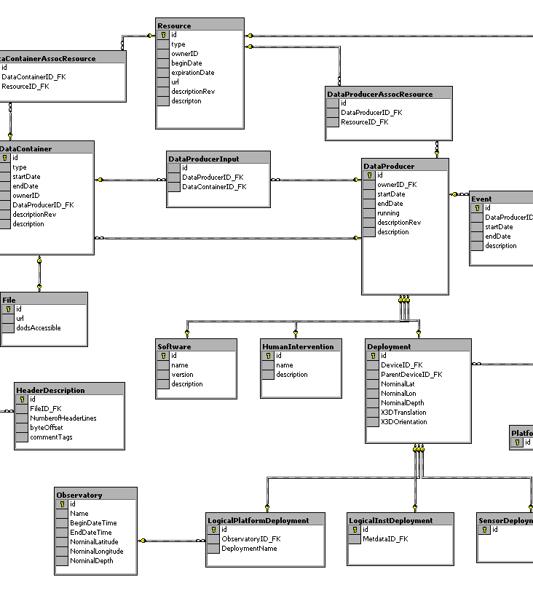
Data Architect’s View: Data Modeling
RDBMS
MongoDB
{
name: {
last: "Dunham”,
first: “Justin”
},
department : "Marketing",
pets: [ “dog”, “cat” ],
title : “Manager",
locationCode: “NYC23”,
benefits : [
{ type : "Health",
plan : “Plus" },
{ type : "Dental",
plan : "Standard”,
optin: true }
]
}
Notes:
Developers and Data Architects need to embrace rich shape design and understand tradeoffs
Migrating to MongoDB likely has SOME amount of info architecture redesign. Pragmatic choices.
On the right we see an example of a document with rich shape. It’s not just name:scalar paris; fields can be lists, including lists of complex structures. We call this embedding.
Now, it’s not required when examining migration to embed everything but with MongoDB you have choices and certainly the “tightly bound” 1:n relationships are well-served by embedding.
Identifying belongs-to 1:n relationships and those entities well-expressed though polymorphism like a Product catalog or an Events collection are some of the reasons you typically end up with a dozen or collections in MongoDB instead of hundreds of tables in traditional RDBMS.

Slide 25
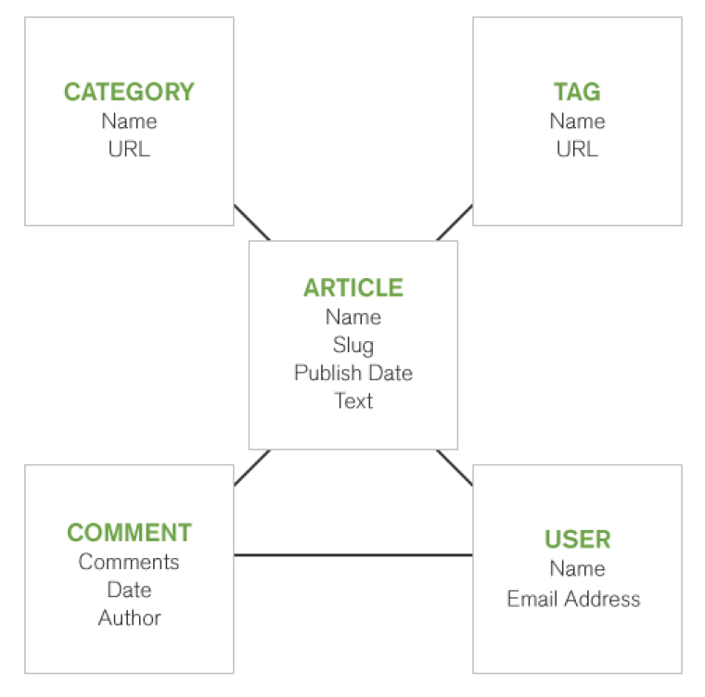
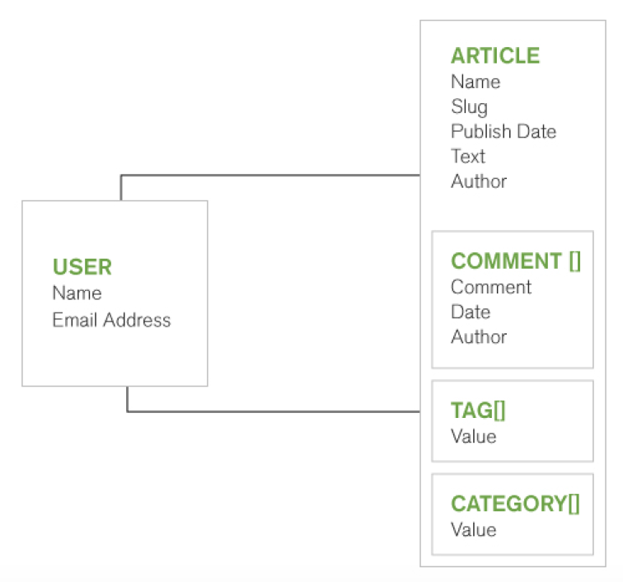
An Example
5 tables in RDBMS | 2 documents in MongoDB
Notes:
Here is an example of a article / blog tracker. The RDBMS team did the theoretically good job by ensuring that 1:n relationships for tag, categories, and comments were set up in their own tables..
All too often especially for “small” things like tags and categories, designers take a shortcut and flatten out the data into the parent Article table, e.g. tag, tag2, and tag3.
Or, to avoid running into the fieldN+1 problem, they create a single column a pack a semicolon delimited list into that column.
In migrating to MongoDB, we’d probably keep the Article and User collections separate but the other entities are well-managed as list fields in the Article document.
We could debate whether certain use cases would suggest moving Comment to its own collection but the point is at least you have choices.
All this is indexable: Compound Indexes
Unique indexes
Array Indexes
Text Indexes
Geospatial indexes
Sparse Indexes

Slide 26
Structures: Beyond Scalars
RDBMS | MongoDB
BUYER_FIRST_NAME
BUYER_LAST_NAME
BUYER_MIDDLE_NAME
INSERT INTO COLL
BUYER_FIRST_NAME
BUYER_LAST_NAME
BUYER_MIDDLE_NAME
Map bn = makeName(FIRST, LAST, MIDDLE);
Collection.insert(
{“buyer_name”, bn});
{
first: “Buzz”,
last: “Moschetti”
}
Select BUYER_FIRST_NAME
BUYER_LAST_NAME
BUYER_MIDDLE_NAME ..
Collection.find(pred, {“buyer_name”:1});
Notes:
Another important design consideration when migrating is adopting structured or nested data.
Let’s explore the value.
We start with BUYER first, middle, and last columns in the RDBMS. We choose to create a structure called consisting of first, last, and middle; in the example above, we’ll leave out middle name on purpose because we can.
Inserting this in the RDBMS requires us to specify all the columns.
In MongoDB, we save the entire structiure as field name buyer_name
Fetching is symmetric in that we ask for buyer_name and get back the struct.
In fairness, the symmetry is also preserved with RDBMS

Slide 27
Graceful Pick-Up of New Fields
RDBMS | MongoDB
BUYER_FIRST_NAME
BUYER_LAST_NAME
BUYER_MIDDLE_NAME BUYER_NICKNAME
INSERT INTO COLL
[prev + NICKNAME]
Map bn = makeName(FIRST, LAST, MIDDLE,NICKNAME);
Collection.insert(
{“buyer_name”, bn});
Collection.find(pred, {“buyer_name”:1});
NO change
Select BUYER_FIRST_NAME
BUYER_LAST_NAME
BUYER_MIDDLE_NAME BUYER_NICKNAME ….
Notes:
Why do all this? Recall what I said at the beginning about overlooking options and new capabilities that MongoDB brings to the table as part of your migration!
Doing this work now will be leveraged in your day 2 and day3 enhancements to the migrated system.
Creating structures makes it easy to add new fields without changing other parts of the code that save and fetch.

Slide 28
New Instances Really Benefit
RDBMS | MongoDB
BUYER_FIRST_NAME
BUYER_LAST_NAME
BUYER_MIDDLE_NAME BUYER_NICKNAME
SELLER_FIRST_NAME
SELLER_LAST_NAME
SELLER_MIDDLE_NAME SELLER_NICKNAME
INSERT INTO COLL
[prev + SELLER_FIRST_NAME, SELLER_LAST_NAME, SELLER….]
Map bn = makeName(FIRST, LAST, MIDDLE,NICKNAME);
Map sn = makeName(FIRST, LAST, MIDDLE,NICKNAME);
Collection.insert(
{“buyer_name”, bn,
“seller_name”: sn});
Select BUYER_FIRST_NAME
BUYER_LAST_NAME
BUYER_MIDDLE_NAME BUYER_NICKNAME
SELLER_FIRST_NAME
SELLER_LAST_NAME
SELLER_MIDDLE_NAME SELLER_NICKNAME
Collection.find(pred,
{“buyer_name”:1, “seller_name”:1});
Easy change
Notes:
But where the approach really shines is when you have several of the same kind of thing that you wish to manage consistently.
Code and data both are clearer and more robustly changed.

Slide 29

… especially on Day 3
BUYER_FIRST_NAME
BUYER_LAST_NAME
BUYER_MIDDLE_NAME BUYER_NICKNAME
SELLER_FIRST_NAME
SELLER_LAST_NAME
SELLER_MIDDLE_NAME SELLER_NICKNAME
LAWYER_FIRST_NAME
LAWYER_LAST_NAME
LAWYER_MIDDLE_NAME LAWYER_NICKNAME
CLERK_FIRST_NAME
CLERK_LAST_NAME
CLERK_NICKNAME
QUEUE_FIRST_NAME
QUEUE_LAST_NAME
…
Need to add TITLE to all names
What’s a “name”?
Did you find them all?
QUEUE is not a “name”
Notes:
Often legacy RDBMS schemas grow over time and end up like the above.
In a greenfield environment you might create a 1:n relationship but our context here day is migration.
In any event, we now have to add TITLE to everything that seems to be a name….
This is a tedious and error-prone process.
Look what has already happened. Somehow along the way, we didn’t add CLERK_MIDDLE_NAME
And this QUEUE thing showed up – which looks a lot like contact name but it isn’t. It is only supposed to have FIRST and LAST name. So it becomes increasingly difficult even to use column name patterns as a means of finding what needs to be changed.

Slide 30
Day 3 with Rich Shape Design
 | MongoDB
Map bn = makeName(FIRST, LAST, MIDDLE,NICKNAME,TITLE);
Map sn = makeName(FIRST, LAST, MIDDLE,NICKNAME,TITLE);
Easy change
Collection.insert({“buyer_name”, bn, “seller_name”: sn});
Collection.find(pred, {“buyer_name”:1, “seller_name”:1});
NO change
Notes:
By adopting structured data, you can take advantage of software to help build and manipulate these items.
And MongoDB makes it easy to store, retrieve, and query them.
And yes, it is possible to extract just parts of the nested structure via the MongoDB projection syntax, e.g. buyer_name.first

Slide 31
Architects: You Have Choices
 | Less Schema Migration | More Schema Migration
Advantages | Less effort to migrate bulk data Less changes to upstack code Less work to switch feed constructors | Use conversion effort to fix sins of past Structured data offers better day 2 agility Potential performance improvements with appropriate 1:n embedding
Challenges | Unnecessary JOIN functionality forced upstack Perpetuating field overloading Perpetuating non-scalar field encoding/formatting | Additional investment in design
Notes:
In the end, you have choice.
And it is a spectrum of effort to value, not a single “do it or don’t do it” proposition.
Data Architects and developers need to work together to find the sweet spot.

Slide 32
Don’t Forget The Formula
Target Value = CurrentValue
+ Pain Relief
– Migration Effort
Even without major schema change, horizontal scalability and mixed read/write performance may deliver desired platform value!
Notes:
With all this talk about schema, it’s important to keep the value formula in mind.
Sometimes, the pain relief provided in the infrastructure space – combined HA/DR, webscale read performance – might be enough to warrant migration LEGACY TABLES and all.
In fact, along those lines, it is possible to take a multiphase approach to the migration where Day 1 go-live has a “suboptimal schema” but value is delivered. The benefit here is all parties from developer to operations can become comfortable running and modifying the new stack. Then, months later, the Phase II optimized schema is activated and the software switched over to use it instead.

Slide 33
DBAs Focus on Leverageable Work
SDLC
Test setup, ALTER TABLE, production release. Does not scale well, i.e. one DBA for one or two apps.
Developers/PIM – already at scale – pick up many tasks
SDLC
Aggregate Activity / Tasks
“TRUE” ADMIN
“TRUE” ADMIN
Monitoring, ops, user/entitlement admin, etc. Scales with number of databases and physical platforms
EXPERTS
Small number, highly leveraged. Scales to overall organization
EXPERTS
Traditional
RDBMS
MongoDB
Notes:
Finally on roles, a brief note on DBAs
We’ve heard people say “With MongoDB you don’t need DBAs” and that’s not true.
You still need – in fact you WANT – DBAs but with MongoDB, you can create value by refocusing DBAs on the leveragable tasks and activities.
In almost any technology, you’ll have a handful of experts. That’s a given.
The next tier contains what should be highly leveragable tasks across many instances of databases.
In fact, I’d assert that it is these tasks that most people believe are what most quote unquote “DBAs” should be doing.
But very often, RDBMS DBAs end up performing a lot of non-leveragable upstack work like basic DDL maintenance.
With MongoDB, many of those tasks can be performed by developers and level 1 ops who are already “at scale”; in other words, the staffing / responsibility profile for these people is already assumed to be narrowly scoped to 1 or 2 apps.

Slide 34

Bulk Migration
Notes:
So now it’s time to actually get some data into MongoDB.
In almost all migrations, at some point early on in development, you’ll want to bulk load old data into the new schema to experiment with performance, indexing, and managability.
And you’ll probably want to turn that crank a few times.
Especially at the start of an effort, you don’t need a robust operationalized, reconciliable incremental update and transfer system.
Also, the operational profile and information architecture of the RDBMS system to be migrated might demand different approaches for extracting and massaging the data.
So let’s take a look at some of our options.

Slide 35
From The Factory: mongoimport
$ head -1 customers.json
{ "name": { "last": "Dunham", "first": "Justin" }, "department" : "Marketing", "pets": [ "dog", "cat" ] , "hire": {"$date": "2012-12-14T00:00:00Z"} ,"title" : "Manager", "locationCode": "NYC23" , "benefits" : [ { "type":"Health", "plan":"Plus" }, { "type" : "Dental", "plan" : "Standard", "optin": true }]}
$ mongoimport --db test --collection customers –drop < customers.json
connected to: 127.0.0.1
2014-11-26T08:36:47.509-0800 imported 1000 objects
$ mongo
MongoDB shell version: 2.6.5
connecting to: test
db.customers.findOne()
{
"_id" : ObjectId("548f5c2da40d2829f0ed8be9"),
"name" : { "last" : "Dunham”, “first" : "Justin” },
"department" : "Marketing",
"pets" : [ "dog”"cat”],
"hire" : ISODate("2012-12-14T00:00:00Z"),
"title" : "Manager",
"locationCode" : "NYC23",
"benefits" : [
{
"type" : "Health",
"plan" : "Plus"
},{
"type" : "Dental",
"plan" : "Standard",
"optin" : true
}
]
}
Notes:
If you can start with CR-delimited JSON (somehow) then mongoimport is a fine way to start.
CR-delimited JSON is easy to produce given almost any input source; it’s easier to construct than XMLbecause field names don’t need closing tags and arrays are natively supported – VERY important and powerful stuff!
And the performance and tunability (i.e. threads and buffer sizes) in mongoimport v 3.0 has been significantly improved.
Safety tip: JSON does not support Dates natively; thus, we use MongoDB type metadata conventions to direct mongoimport to treat strings as Dates as shown in green above. DO NOT allow dates to come across as strings or integers! Many of the problems in data transfer involve loss of type fidelity so nip that in the bud at the start.
CR-delimited JSON is actually pretty powerful in its own right. Standard systems tools for counting lines and such work well on it and opern source tools like jq can be brought to bear on it.
As you can imagine, it also compresses pretty well.

Slide 36
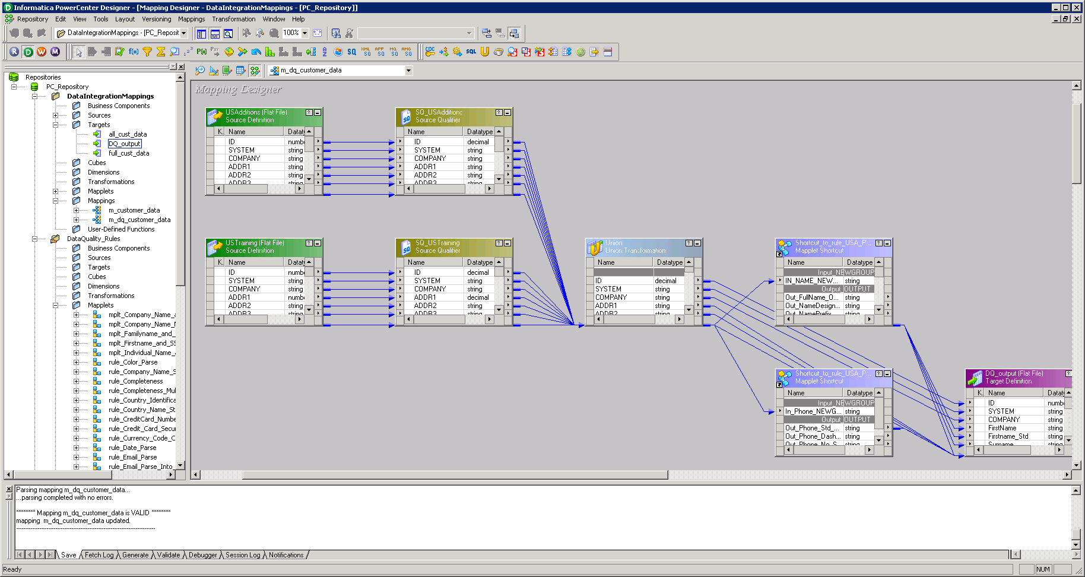


Traditional vendor ETL
Source Database
ETL
Notes:
Of course, there is ETL, and the way you’d use it HERE is pretty much much the same way you’ve always designed, configured, and operated it.
Pentaho & Informatica have partnership with MongoDB
GUI based tools
As powerful tools, they offer Mapping, workflow that transform, change schema along the way
Can handle different sources
Stable, robust, scalable migrations for large, complex data sets.
Pentaho in particular embraces rich shape and has decent capability around “merging” RDBMS tables into more complex MongoDB embedded documents.
But there are limitations in this space.
IMPORTANT POINT: In general, design for the “best” model in MongoDB and employ the “best” ETL tool that can get you there. We mentioned this earlier: do not let the tail wag the dog. In this case, do not let certain conveniences or shortcuts in the ETL environment drive data modeling decisions in MongoDB.

Slide 37
Community Efforts
github.com/bryanreinero/Firehose
Componentized CLI, DB-writer, and instrumentation modules
Multithreaded
Application framework
Good starting point for your own custom loaders
Notes:
The mongoDB community is very large – we’re approaching 10 million downloads,
Many people have built interesting tools that specialize in one thing or another and can be added to your bulk migration arsenal.
Firehose is one example that specializes in loading and diagnostic functions but exposes them in a way to make it easy for you to incorporate into your apps should you desire to do so.

Slide 38
Community Efforts
github.com/buzzm/mongomtimport
High performance Java multithreaded loader
User-defined parsers and handlers for special transformations
Field encrypt / decrypt
Hashing
Reference Data lookup and incorporation
Advanced features for delimited and fixed-width files
Type assignment including arrays of scalars
Notes:
mongomtimport mimics most of the factory mongoimport functionality but permits user-defined and compiled parser and/or data handlers to be supplied on the command line. This gives you essentially unlimited functional capability that can operate on each document prior to being inserted into MongoDB.

Slide 39
Shameless Plug for r2m
github.com/buzzm/r2m
Perl DBD/DBI based framework
Highly customizable but still “framework-convenient”
# r2m script fragment
collections => {
peeps => {
tblsrc => "contact",
flds => {
name => [ "fld", {
colsrc => ["FNAME”,"LNAME"],
f => sub {
my($ctx,$vals) = @_;
my $fn = $vals->{"FNAME”};
$fn = ucfirst(lc($fn));
my $ln = $vals->{"LNAME"};
$ln = ucfirst(lc($ln));
return { first => $fn,
last => $ln };
}
}]
Collection “peeps”
{
name: {
first: “Bob”,
last: “Jones”
}
. . .
}
{
name: {
first: “Matt”,
last: “Kalan”
}
. . .
}
CONTACT
FNAME | LNAME
JONES | BOB
KALAN | MATT
Notes:
Lastly, as an old time Perl hacker, I will shameless plug r2m. R2m brings the RAD and expressive power of perl together with a mongo loader framework to enable complex data manipulation and shape transformation.
Because it uses the DBD/DBI framework as an input source, it can not only connect to all the RDBMSs but also Excel, web services, flatfiles, etc. There are literally dozens of DBD adapters you can use
In this example, I am sure I could have changed the example above to fit in 3 lines instead of 6 but we’re going for clarity here.
A flat structure of uppercased data is transformed into a nested structure of capitalized names.
The iteration over the CONTACT table and other common logic like type conversion is handled by the framework.

Slide 40
r2m works well for 1:n embedding
#r2m script fragment
…
collections => {
peeps => {
tblsrc => ”contact",
flds => {
lname => “LNAME",
phones => [ "join", {
link => [“uid", “xid"]
},
{ tblsrc => "phones",
flds => {
number => "NUM”,
type => "TYPE”
}
}]
}
}
Collection “peeps”
{
lname: “JONES”,
phones: [
{ "number”:”272-1234",
"type" : ”HOME” },
{ "number”:”272-4432",
"type" : ”HOME” },
{ "number”:”523-7774",
"type" : ”HOME” }
]
. . .
}
{
lname: “KALAN”,
phones: [
{ "number”:”423-8884",
"type" : ”WORK” }
]
}
CONTACT
FNAME | LNAME | UID
JONES | BOB | 1
KALAN | MATT | 2
PHONES
NUM | TYPE | XID
272-1234 | HOME | 1
272-4432 | HOME | 1
523-7774 | HOME | 1
423-8884 | WORK | 2
Notes:
R2m also makes it fairly easy to create 1:n embedding of Lists through the “join” function.
And of course, in the end, with drivers for 10 languages including agile ones like python, perl, ruby, and javascript, you can always WRITE YOUR OWN.

Slide 41

System Cutover
Notes:
Cutover is NOT something you think about one month before the event.
It’s important and useful to think about system cutover very early in the migration effort because you have some options.
Depending on your tolerance for downtime, failback, and investment in new code in the stack, you can adopt different approaches for making this happen.

Slide 42

STOP … and Test
Way before you go live, TEST
Try to break the system
ESPECIALLY if performance and/or scalability was a major pain relief factor
Notes:
This slide brought to you by the patient Technical Support Engineering staff at MongoDB, who have received many a frantic call about go-live in 24 hours and “something not working.”
Build scripts that pound the DB and push the machine and disks to the max.
Identify your first bottlenecks that lie ahead of your stated performance requirements.
Remember: You don’t have a lot of experience and years worth of built-in assumptions about how this system SHOULD perform.

Slide 43


“Hours” Downtime Approach
Apps
Apps
Apps
Apps
Apps
Apps
POJOs
POJOs
POJOs
POJOs
POJOs
POJOs
ORM
DAL
ORM
DAL
ORM
DAL
SQL / ResultSet
MongoDB
Drivers
SQL / ResultSet
MongoDB
Drivers
SQL / ResultSet
MongoDB
Drivers
JDBC
JDBC
JDBC
RDBMS
RDBMS
RDBMS
LIVE ON OLD STACK
“MANY HOURS ONE SUNDAY NIGHT…”
LIVE ON NEW STACK
Notes:
PROS:
Very conservative; little or no direct impact on live old stack In fact, you can blur migrate and rewrite here.
Oftimes an entire copy of the stack is made so breaking changes can be introduced and dealt with across the stack without a giant coordinated release.
CONS
That Sunday is going to be a doozie!
Unclear what failback looks like
Variation: Partition data in some way (region? User sets?) and run dual live ; requires app topside changes to put user onto the right stack

Slide 44
“Minutes” Downtime Approach
Apps
Apps
Apps
POJOs
POJOs
POJOs
DAL
DAL
DAL
ORM
MongoDB
Drivers
ORM
MongoDB
Drivers
ORM
MongoDB
Drivers
SQL / ResultSet
SQL / ResultSet
SQL / ResultSet
JDBC
JDBC
JDBC
RDBMS
RDBMS
RDBMS
SOFTWARE
SWITCHOVER
LIVE ON MERGED STACK
BLOCK ACTIVITY, COMPLETE LAST “FLUSH” OF DATA
Notes:
PROS:
Gets a DAL in there which is good.
Can periodically test thru special pathways into staged MongoDB stack
Reasonable failback
CONS:
You may not want / be able to engineer in a DAL.
Last flush of activity might be longer than minutes

Slide 45
Zero Downtime Approach
Shepherd
Apps
Apps
3
POJOs
POJOs
Low-level
Shepherd
2
T
4
DAL
DAL
1
ORM
MongoDB
Drivers
MongoDB
Drivers
SQL / ResultSet
JDBC
RDBMS
DAL submits operation to MongoDB “side” first
If operation fails, DAL calls a shunt [T] to the RDBMS side and copies/sync state to MongoDB. Operation (1) is called again and succeeds
“Disposable” Shepherd utils can generate additional conversion activity
When shunt records no activity, migration is complete; shunt can be removed later
Notes:
PROS:
Continuous incremental migration.
CONS
Some environments might not tolerate performance hit of copy/sync
Still a Day 1 migration event when new stack goes live
NEEDS VERY GOOD TESTING

Slide 46
MongoDB Is Here To Help
MongoDB Enterprise Advanced
The best way to run MongoDB in your data center
MongoDB Management Service (MMS)
The easiest way to run MongoDB in the cloud
Production Support
In production and under control
Development Support
Let’s get you running
Consulting
We solve problems
Training
Get your teams up to speed.
Notes:
You don’t have to go at this alone.

Slide 47









Migration Success stories
Notes:
Migration has worked and has produced value for a number of projects
Edmunds – Billing, online advertising, user data (Oracle)
Metlife – Single view of 100M+ customers and 70 systems in 90 days
Cisco - Analytics, Social Networking (Various)
Salesforce – Real time analytics (Various)
Expedia – Special travel offers in real time
Adobe – Digital experience management platform
Shutterfly – Developed nearly a dozen projects on MongoDB storing more than 20TB data (Oracle) Need for Rich shape management and legacy pain of RDMS produced value.
Craigslist – Archive data migration (MySQL)
MTV - Centralized Content Management (Various)
(Large broker / dealer did reference data conversion which led to direct reduction in cost of 10mm and follow on saves of 30mm)

Slide 48
Questions & Answers

Slide 49
Thank you
Notes:
On behalf of all of us at MongoDB , thank you for attending this webinar!
I hope what you saw and heard today gave you some insight and clues into what you might face in your own migration efforts.
Remember you can always reach out to us at MongoDB for guidance.
And with that, Code well, and be well!

